Slide 1
About ALEXANDER BORISOVICH RASKIN
How Daddy Played Ping Pong

Slide 2
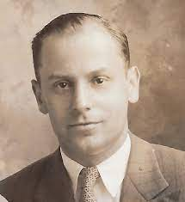
RUSIAN WRITER AND POET
He was born in Belarus and studied at the Literary Institute in Moscow. He became famous for his humorous and satirical writing.
Famous book – When Daddy was a little BOY
Born 1914
Death 1971

Slide 3
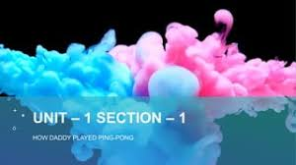
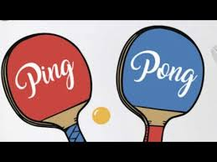
About the Author Alexander Raskin was a famous Russian author and poet. His stories are very interesting , realistic and funny. They go from when he was a boy to when he became a young pioneer. One of his widely recognized works is When Daddy was a Little Boy, a largely autobiographical book about his childhood. So, the story How Daddy Played Ping – pong is a collection of this work only.

Slide 4
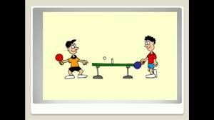
Why is table tennis called ping pong?
It is derived from 'ping pang qiu' in Mandarin Chinese (same pronunciation) which translates literally to “ping pong ball.”
It is Other wise called Table Tennis

Slide 6
Quiz
https://quizizz.com/admin/quiz/5ee2dab9fa0df0001b2fe9c2/how-daddy-played-ping-pong
Video
https://youtu.be/XfX0DN3wMO8

Slide 7
Moral of the story: We realize our parents’ concern, when we become parents.
UNIT – 1 ( NEW WORDS)
ping – pong - another term for table tennis
2. invented – create or design
amazed – greatly surprised
4. the end of him – his downfall
5. fascinated – strongly attracted and interested 6. thunderstruck – surprised or shocked
7. shrugged – disregard
8. summoned – order someone to be present
9. playing hooky – to avoid or skip school or work without permission
10. awful – very bad or unpleasant
Kindly write new words in the notebook.

Slide 8
Thank you

